Slide 1

Case Study on magicbricks.com

Slide 2
Team A.R.M.Y
Namita.G
Swathi.P

Slide 3
About
MagicBricks, a real estate platform, was founded in 2006.
It is a division of Times Internet Limited, a wholly owned subsidiary of Bennett, Coleman & Co. Ltd.
It is a website that provides a common platform for property buyers & sellers to locate properties of interest in India, and source information about all property related issues.
In April 2011, Magicbricks introduced the mobile website with features like mobile searches for property, agent, builder and price trends.

Slide 4
Accessing MagicBricks
URL:
http://www.magicbricks.com

Slide 5
Services
Buying and selling properties.
News section which includes property news, home loans concerns, legal & taxation issues, expert opinion and analysis of property trends.
Buyer's Guide covers all the essential steps and stages entailed in property buying and contains answers, quick tips and expert advice on what to look for and how to manage property buying.
PropIndex, a tool, empowers property seekers and investors with detailed information on the movement of residential apartment prices and supply of properties.

Slide 6
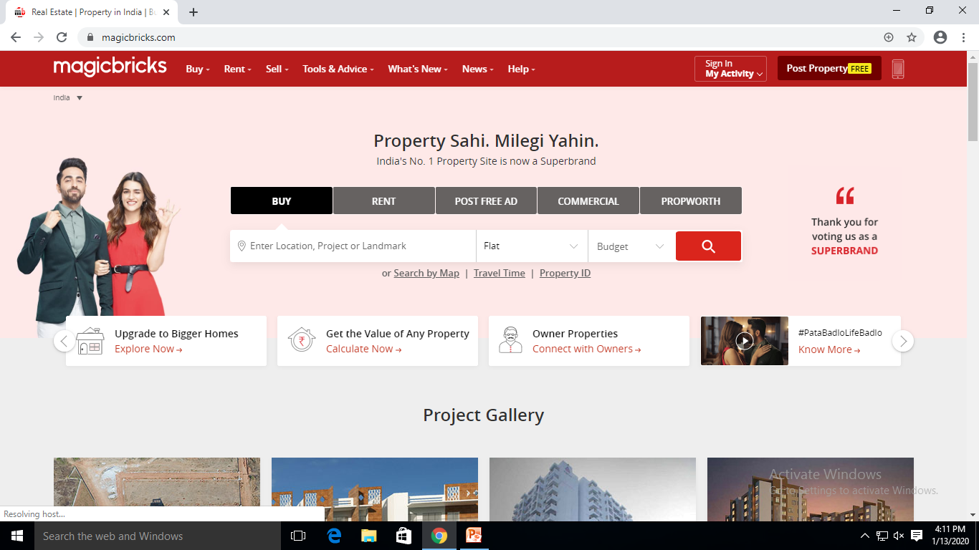
magicbricks.com

Slide 7
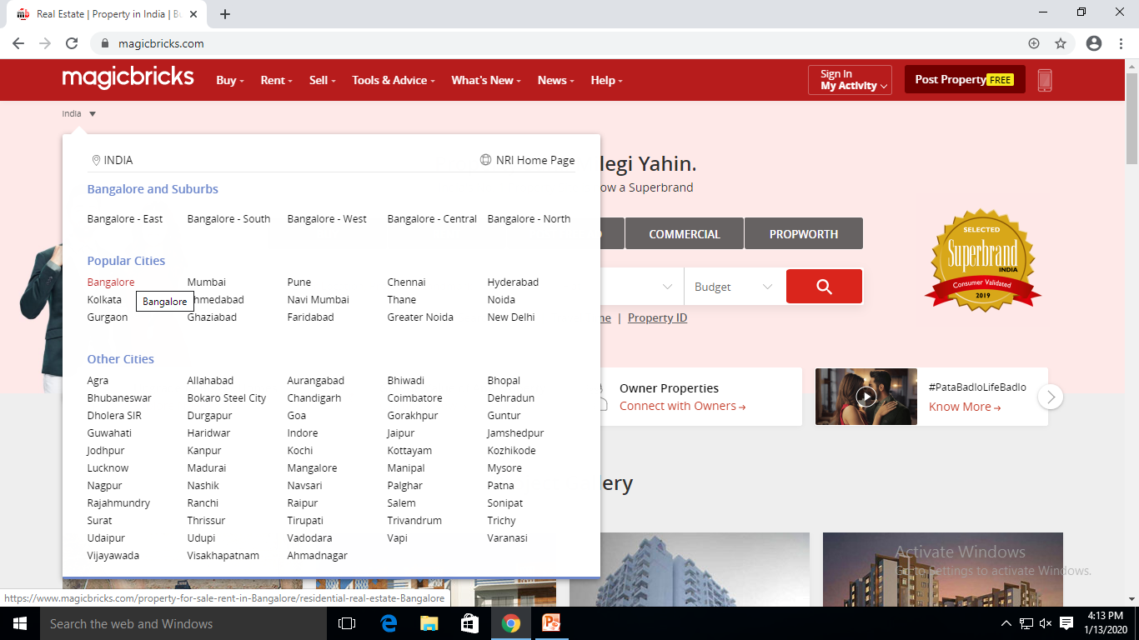
Location-wise Navigation

Slide 8
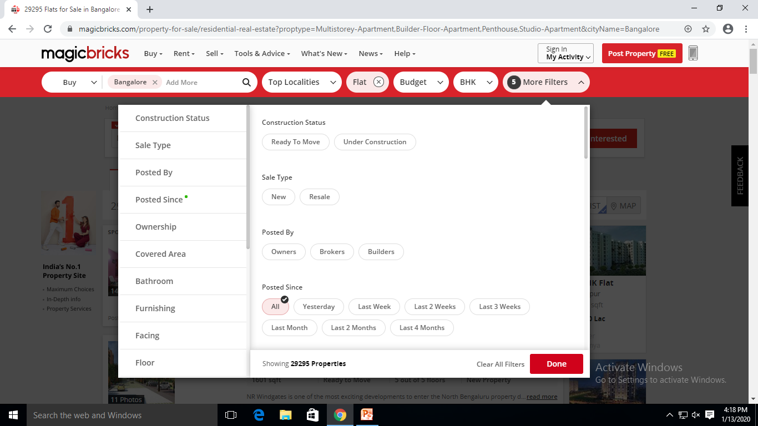
Range of Filters

Slide 9
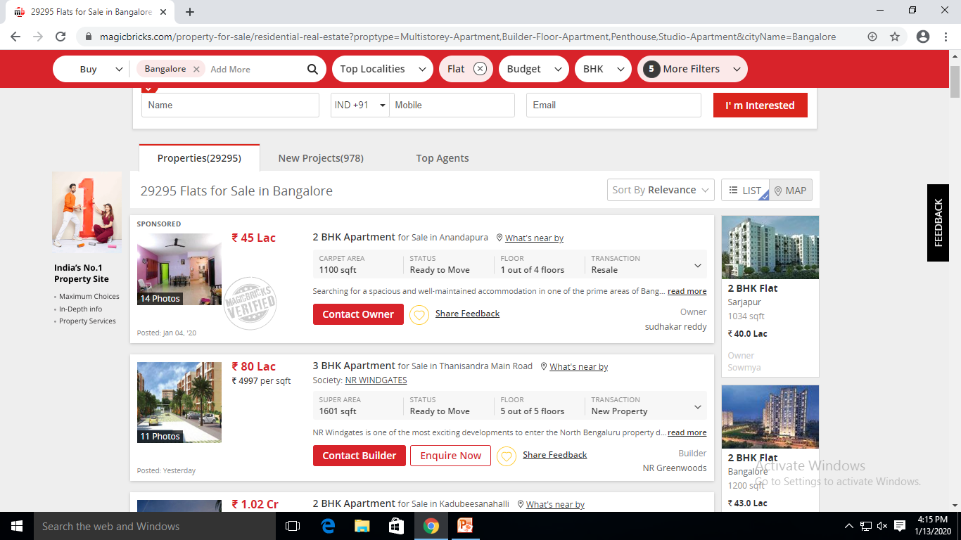
Properties Listed by Choice

Slide 10
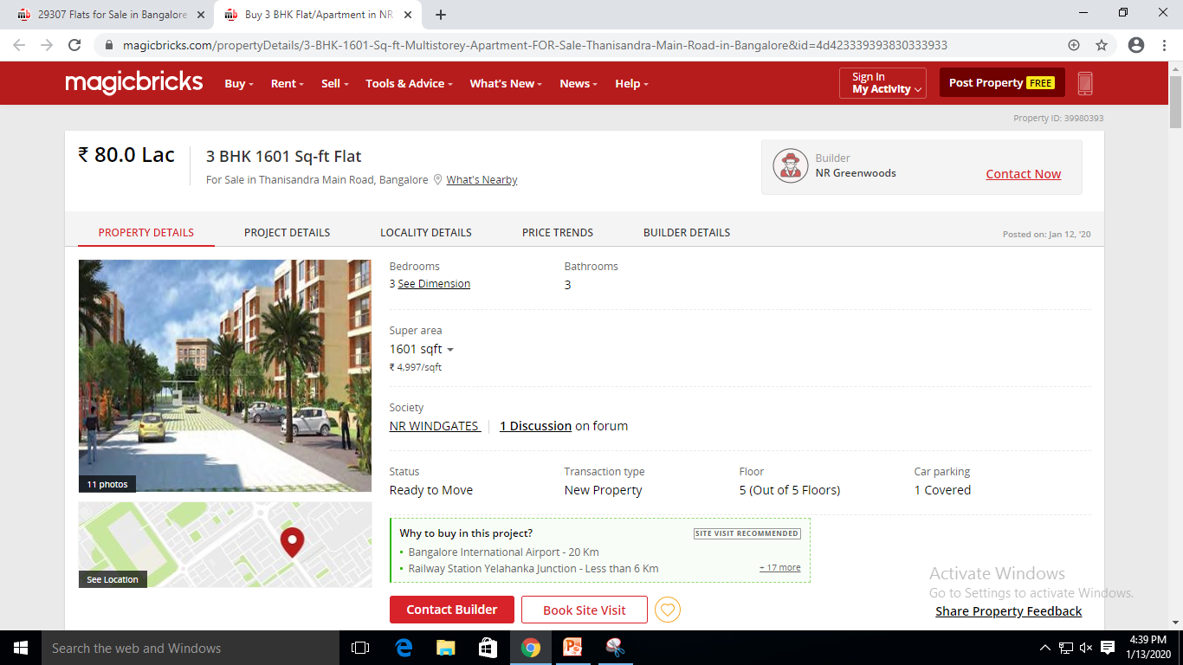
Property Details and Amenities

Slide 11
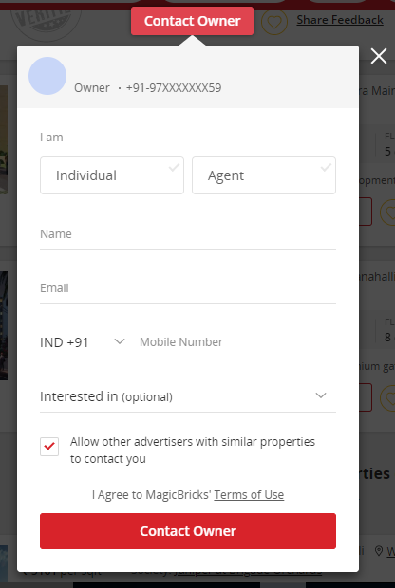
Contact Owner

Slide 12
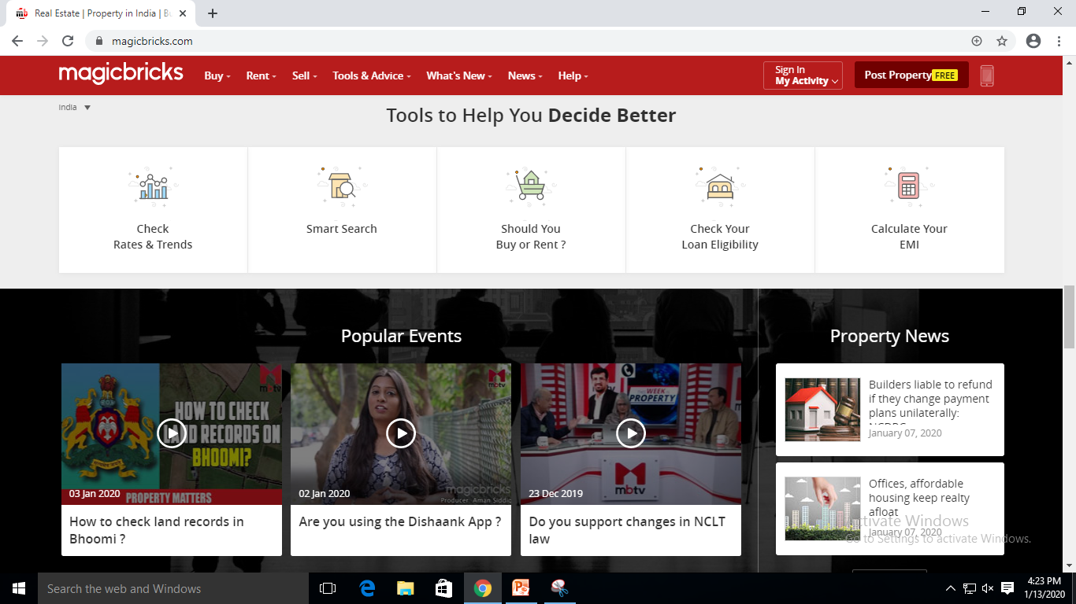
Other Services and Tools

Slide 13
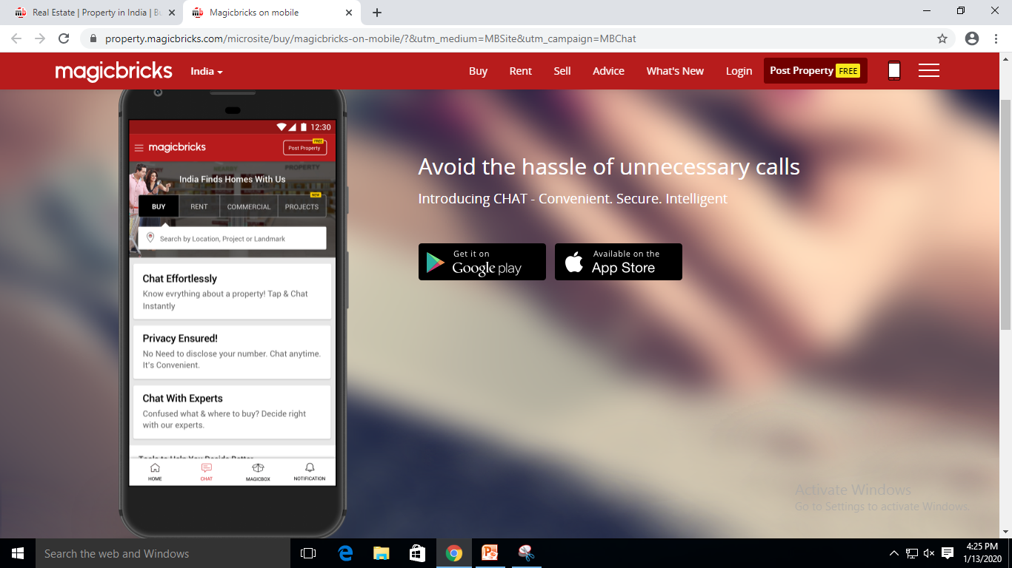
Magicbricks Mobile

Slide 14
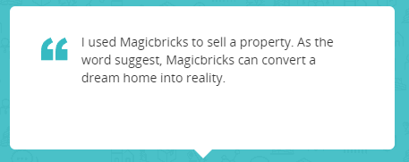
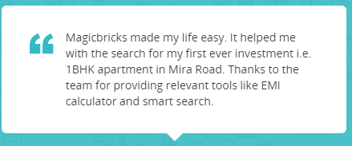
Customer Reviews

Slide 15


